Slide 1

Clustering – Part 1
Data Mining– Final Week 4
Humaira Anzum Neha
Lecturer
Dept of CSE, UIU
humaira@cse.uiu.ac.bd

Slide 2

What is Clustering?
Clustering is a technique used in machine learning to group similar objects or data points based on their characteristics or patterns.
It’s unsupervised learning, meaning it doesn’t need labeled data but finds patterns in data by itself.
The goal is to divide data into groups (clusters) where items in each cluster are similar to each other but different from items in other clusters.

Slide 3
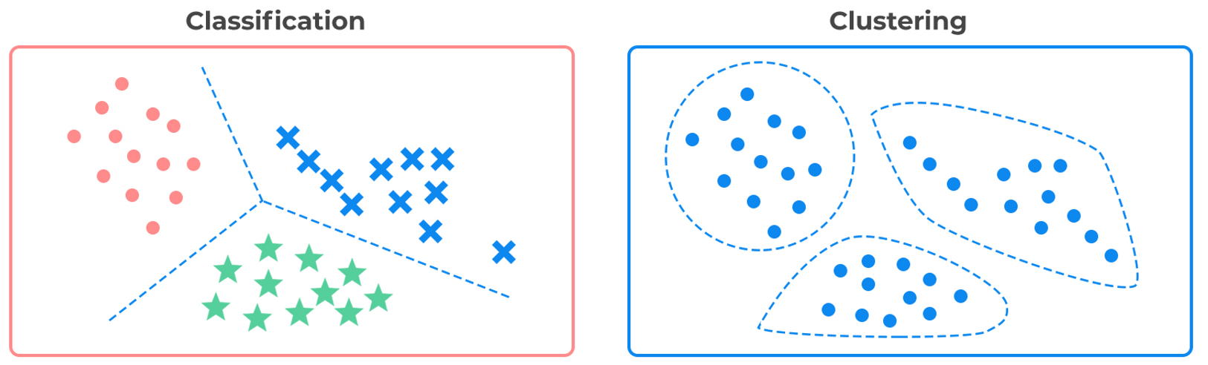
What is Clustering?
Notes:
Applications of Clustering:
Search Engines: Group similar web pages or search results.
Customer Segmentation: Group customers based on behavior like purchasing history.
Anomaly Detection: Spot unusual patterns in data.
Semi-supervised Learning: Combine labeled and unlabeled data for learning.

Slide 4
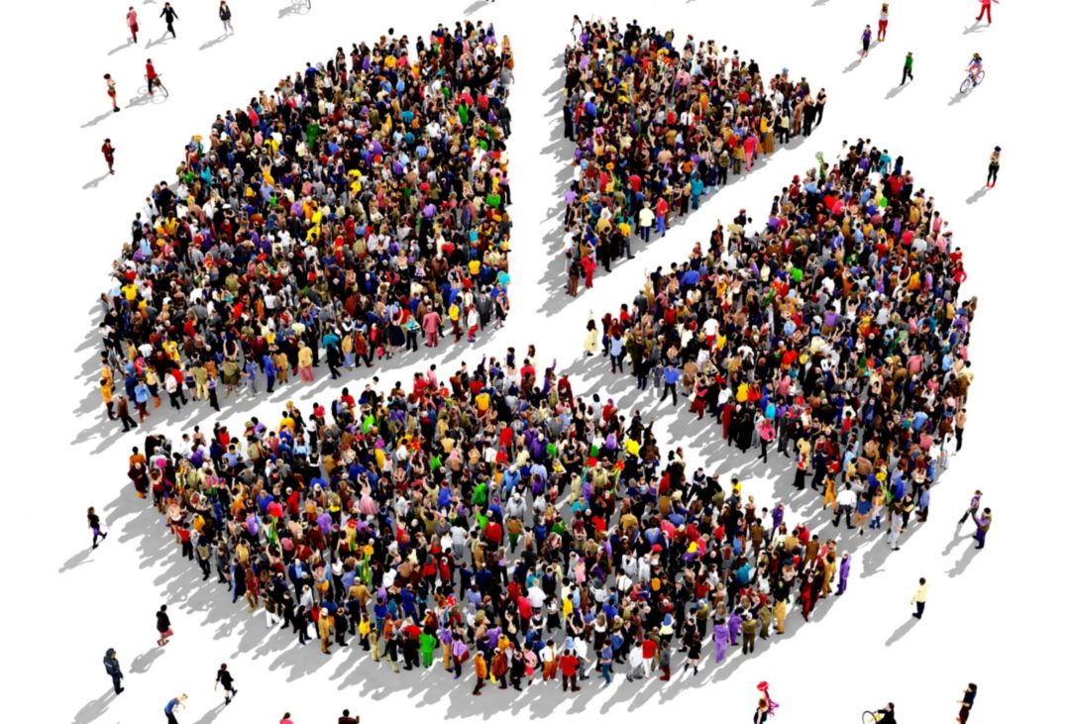

Broad Applications of Cluster Analysis
Search engines
Customer Segmentation
cluster our customers based on their purchase history and their activity on our website.
Notes:
Applications of Clustering:
Search Engines: Group similar web pages or search results.
Customer Segmentation: Group customers based on behavior like purchasing history.
Anomaly Detection: Spot unusual patterns in data.
Semi-supervised Learning: Combine labeled and unlabeled data for learning.

Slide 5
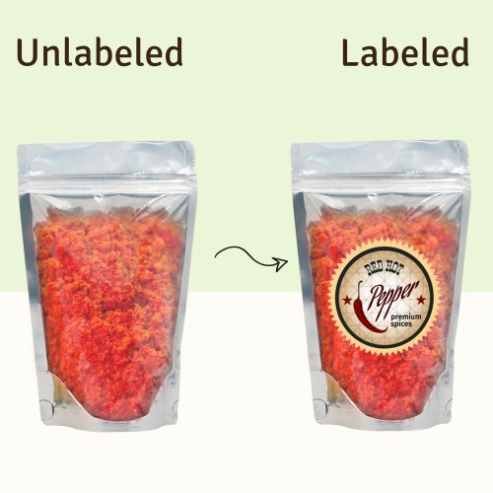

Broad Applications of Cluster Analysis
Anomaly detection
Semi Supervised Learning
Notes:
Applications of Clustering:
Search Engines: Group similar web pages or search results.
Customer Segmentation: Group customers based on behavior like purchasing history.
Anomaly Detection: Spot unusual patterns in data.
Semi-supervised Learning: Combine labeled and unlabeled data for learning.

Slide 6
Considerations for Cluster Analysis
Partitioning criteria
Single level vs. hierarchical partitioning (often, multi-level hierarchical partitioning is desirable, e.g., grouping topical terms)
Separation of clusters
Exclusive (e.g., one customer belongs to only one region) vs. non-exclusive (e.g., one document may belong to more than one class)
Similarity measure
Distance-based (e.g., Euclidean, road network, vector) vs. connectivity-based (e.g., density or contiguity)
Clustering space
Full space (often when low dimensional) vs. subspaces (often in high-dimensional clustering)
Notes:
Important Considerations in Clustering:
Partitioning Criteria: Single-level (simple) or hierarchical (complex) clusters.
Separation of Clusters: Exclusive (one data point belongs to one group) or non-exclusive (can belong to multiple groups).
Similarity Measure: Based on distance (e.g., Euclidean) or connectivity (e.g., density).
Clustering Space: Full space for low dimensions, subspace for high dimensions.

Slide 7
Cluster Analysis: A Multi-Dimensional Categorization
Technique-Centered
Distance-based methods
Density-based and grid-based methods
Probabilistic and generative models
Leveraging dimensionality reduction methods
High-dimensional clustering
Scalable techniques for cluster analysis
Data Type-Centered
Clustering numerical data, categorical data, text data, multimedia data, time-series data, sequences, stream data, networked data, uncertain data
Notes:
Types of Clustering Methods:
Partitioning Methods: Divide data into a set number of clusters (e.g., K-Means, K-Medoids).
Hierarchical Methods: Build a tree of clusters (e.g., DIANA, BIRCH).
Density-Based Methods: Group points based on density (e.g., DBSCAN).
Grid-Based Methods: Divide the space into a grid structure (e.g., STING).

Slide 8
Major Clustering Approaches
Partitioning approach:
Construct various partitions and then evaluate them by somecriterion, e.g., minimizing the sum of square errors
Finds mutually exclusive clusters of spherical shape
Typical methods: k-means, k-medoids, CLARANS
Hierarchical approach:
Create a hierarchical decomposition of the set of data (or objects)
using some criterion
Typical methods: Diana, Agnes, BIRCH, CAMELEON

Slide 9
Major Clustering Approaches
Density-based approach:
Based on connectivity and density functions
Each point must have minimum no. of points in his neighbourhood
Can find arbitrary shape
Filter out outliers
Typical methods: DBSCAN, OPTICS, DenClue
Grid-based approach:
based on a multiple-level granularity structure
Fast processing time
Typical methods: STING, WaveCluster, CLIQUE

Slide 10
Cluster Analysis: Partitioning approach
Partitioning method:
Partitioning a dataset D of n objects into a set of k (C1,C2,…,Ck) clusters, such that the sum of squared distances is minimized (where ci is the centroid or medoid of cluster Ci).
It optimizes an objective criteria
a dissimilarity function based on distance so that objects in a cluster are similar and dissimilar to other clusters
E is the sum of square error / inertia that to be minimized
dist(x,y) is the Euclidean distance between two points x and y.
p is a point in the space p∈C_{i}
p and c_{i} are multidimensional

Slide 11
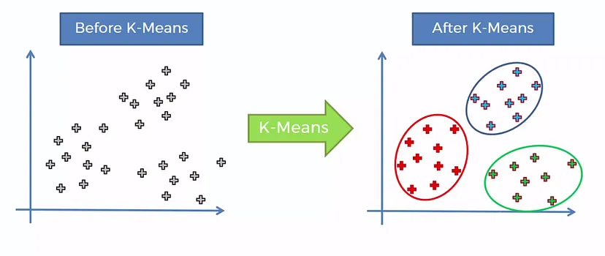
The K-Means Clustering Method
K-means clustering is a popular unsupervised machine learning algorithm used to group data points into K clusters based on their similarity.
The K in K-means represents the number of clusters that the algorithm will create.
Each cluster is represented by the centroid of the cluster
K-means clustering aims to minimize the sum of squared distances between each data point and its assigned centroid. This means that the algorithm is trying to find the cluster centroids that minimize the variance within each cluster and maximize the distance between clusters.

Slide 12
The K-means Algorithm
Initialization: Select the number of clusters (K) and randomly initialize K cluster centroids in the feature space.
Assignment: Assign each data point to the nearest cluster centroid based on the Euclidean distance or any given distance function between the data point and each centroid.
Update: Compute the mean of each cluster, which becomes the new centroid for that cluster.
Repeat: Repeat steps 2 and 3 until the centroids no longer change or a maximum number of iterations is reached.
Convergence: Once convergence is reached, the K clusters represent groups of data points that are similar to each other and dissimilar to data points in other clusters.
Notes:
K-Means Clustering Method:
Steps:
Initialization: Choose the number of clusters (K) and randomly assign centroids.
Assignment: Assign each data point to the nearest centroid.
Update: Calculate new centroids based on the assigned data points.
Repeat: Continue until the centroids don’t change or the maximum number of iterations is reached.
Goal: Minimize the sum of squared distances between data points and their assigned centroids.

Slide 13
Example of K-means clustering
Cluster the following eight points (with (x, y) representing locations) into three clusters:
A1(2, 10), A2(2, 5), A3(8, 4), A4(5, 8), A5(7, 5), A6(6, 4), A7(1, 2), A8(4, 9).
Initial cluster centers are: A1(2, 10), A4(5, 8) and A7(1, 2).
The distance function between two points a = (x1, y1) and b = (x2, y2) is defined as
Ρ(a, b) = |x2 — x1| + |y2 — y1|
Use K-Means Algorithm to find the three cluster centers after the second iteration.
Notes:
Example of K-Means:
Points: A1(2,10), A2(2,5), A3(8,4), etc.
Initial cluster centers: A1(2,10), A4(5,8), A7(1,2).
After iterations, new centers are computed by taking the mean of points in each cluster.

Slide 14
Example of K-means clustering
A1(2, 10), A2(2, 5), A3(8, 4), A4(5, 8), A5(7, 5), A6(6, 4), A7(1, 2), A8(4, 9).
Initial cluster centers are: A1(2, 10), A4(5, 8) and A7(1, 2).
Iteration-01:
Calculating Distance Between A1(2, 10) and C1(2, 10)
Ρ(A1, C1)
= |x2 — x1| + |y2 — y1|
= |2–2| + |10–10|
= 0
Calculating Distance Between A1(2, 10) and C2(5, 8)
Ρ(A1, C2)
= |x2 — x1| + |y2 — y1|
= |5–2| + |8–10|
= 3 + 2
= 5
Calculating Distance Between A1(2, 10) and C3(1, 2)
Ρ(A1, C3)
= |x2 — x1| + |y2 — y1|
= |1–2| + |2–10|
= 1 + 8
= 9

Slide 15
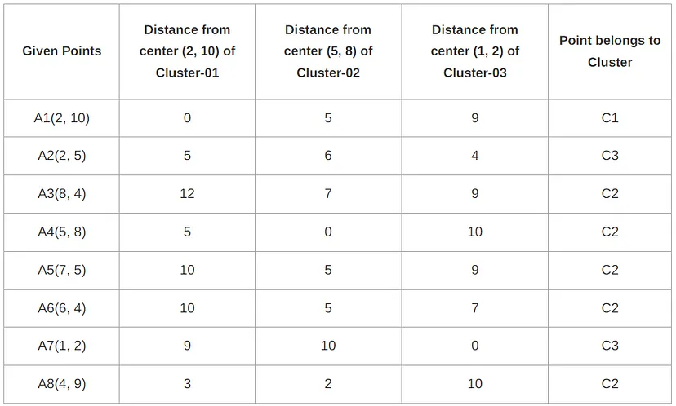
Example of K-means clustering
Cluster-01:
The first cluster contains points-
A1(2, 10)
Cluster-02:
The second cluster contains points-
A3(8, 4)
A4(5, 8)
A5(7, 5)
A6(6, 4)
A8(4, 9)
Cluster-03:
The third cluster contains points-
A2(2, 5)
A7(1, 2)

Slide 16
Example of K-means clustering
A1(2, 10), A2(2, 5), A3(8, 4), A4(5, 8), A5(7, 5), A6(6, 4), A7(1, 2), A8(4, 9).
Re-compute the new cluster clusters.
The new cluster center is computed by taking mean of all the points contained in that cluster.
For Cluster-01:
We have only one point A1(2, 10) in Cluster-01.
So, the cluster center remains the same.
For Cluster-02:
Center of Cluster-02
= ((8 + 5 + 7 + 6 + 4)/5, (4 + 8 + 5 + 4 + 9)/5)
= (6, 6)
For Cluster-03:
Center of Cluster-03
= ((2 + 1)/2, (5 + 2)/2)
= (1.5, 3.5)
This is the completion of Iteration-01.
Cluster-01:
The first cluster contains points-
A1(2, 10)
Cluster-02:
The second cluster contains points-
A3(8, 4)
A4(5, 8)
A5(7, 5)
A6(6, 4)
A8(4, 9)
Cluster-03:
The third cluster contains points-
A2(2, 5)
A7(1, 2)

Slide 17
Example of K-means clustering
A1(2, 10), A2(2, 5), A3(8, 4), A4(5, 8), A5(7, 5), A6(6, 4), A7(1, 2), A8(4, 9).
C1(2, 10) C2(6, 6), C3(1.5, 3.5)
Iteration-02:
Calculating Distance Between A1(2, 10) and C1(2, 10)
Ρ(A1, C1)
= |x2 — x1| + |y2 — y1|
= |2–2| + |10–10|
= 0
Calculating Distance Between A1(2, 10) and C2(6, 6)
Ρ(A1, C2)
= |x2 — x1| + |y2 — y1|
= |6–2| + |6–10|
= 4 + 4
= 8
Calculating Distance Between A1(2, 10) and C3(1.5, 3.5)
Ρ(A1, C3)
= |x2 — x1| + |y2 — y1|
= |1.5–2| + |3.5–10|
= 0.5 + 6.5
= 7

Slide 18
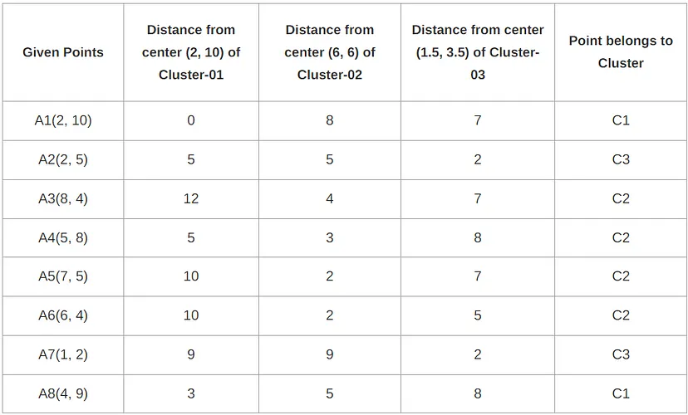
Example of K-means clustering
From here, New clusters are:
Cluster-01:
The first cluster contains points-
A1(2, 10)
A8(4, 9)
Cluster-02:
The second cluster contains points-
A3(8, 4)
A4(5, 8)
A5(7, 5)
A6(6, 4)
Cluster-03:
The third cluster contains points-
A2(2, 5)
A7(1, 2)

Slide 19
Example of K-means clustering
A1(2, 10), A2(2, 5), A3(8, 4), A4(5, 8), A5(7, 5), A6(6, 4), A7(1, 2), A8(4, 9).
Re-compute the new cluster clusters.
The new cluster center is computed by taking mean of all the points contained in that cluster.
For Cluster-01:
Center of Cluster-01
= ((2 + 4)/2, (10 + 9)/2)
= (3, 9.5)
For Cluster-02:
Center of Cluster-02
= ((8 + 5 + 7 + 6)/4, (4 + 8 + 5 + 4)/4)
= (6.5, 5.25)
For Cluster-03:
Center of Cluster-03
= ((2 + 1)/2, (5 + 2)/2)
= (1.5, 3.5)
This is the completion of Iteration-02.
After the second iteration, the center of the three clusters is:
C1(3, 9.5)
C2(6.5, 5.25)
C3(1.5, 3.5)
Cluster-01:
The first cluster contains points-
A1(2, 10)
A8(4, 9)
Cluster-02:
The second cluster contains points-
A3(8, 4)
A4(5, 8)
A5(7, 5)
A6(6, 4)
Cluster-03:
The third cluster contains points-
A2(2, 5)
A7(1, 2)

Slide 20
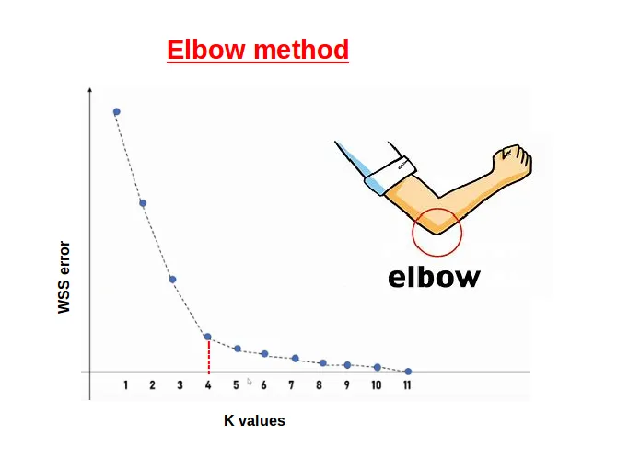
How to choose value of K
In the Elbow Method, we systematically experiment with different numbers of clusters (K) ranging from 1 to 10. With each K value, we compute the Within-Cluster Sum of Squares (WCSS). When we plot WCSS against K, the resulting graph resembles an elbow. As we increase the number of clusters, the WCSS value begins to decrease. Notably, the WCSS is at its highest when K=1.
Notes:
Choosing the Value of K:
Elbow Method: Plot the Within-Cluster Sum of Squares (WCSS) against different values of K. The "elbow" point on the graph suggests the best number of clusters

Slide 21
Comments on the K-Means Method
Weakness
Applicable only to objects in a continuous n-dimensional space
Using the k-modes method for categorical data
In comparison, k-medoids can be applied to a wide range of data
Need to specify k, the number of clusters, in advance
Sensitive to noisy data and outliers
Not suitable to discover clusters with non-convex shapes
Notes:
K-Means Weaknesses:
It only works well with continuous data.
It is sensitive to noisy data and outliers.
Struggles to detect non-convex shapes of clusters.

Slide 22
Variations of K-Means
Choosing better initial centroid estimates
K-means++, Intelligent K-Means, Genetic K-Means
Choosing different representative prototypes for the clusters
K-Medoids, K-Medians, K-Modes
Applying feature transformation techniques
Weighted K-Means, Kernel K-Means
Notes:
Variations of K-Means:
K-Means++: Improved method for choosing initial centroids to avoid poor clustering results.
K-Medoids: Use medoids (data points) instead of centroids to handle outliers better.
Kernel K-means (RBF Kernel):If you have a dataset and it is not linearly separable,then use Kernel K-means (RBF Kernel).
Hierarchical Clustering: Ideally, we would not know how many clusters should we have, in the beginning of the algorithm and hence it a challenge with K-means.This is a gap hierarchical clustering bridges with aplomb. It takes away the problem of having to pre-define the number of clusters.
K-Medians: Use the median instead of the mean, making it more robust to outliers.
K-mode: Remove the weakness of not being able to use categorical data by K means.

Slide 23
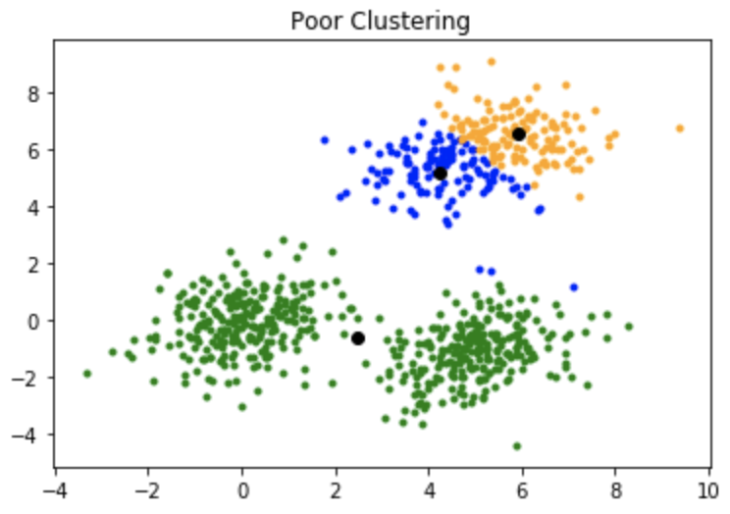
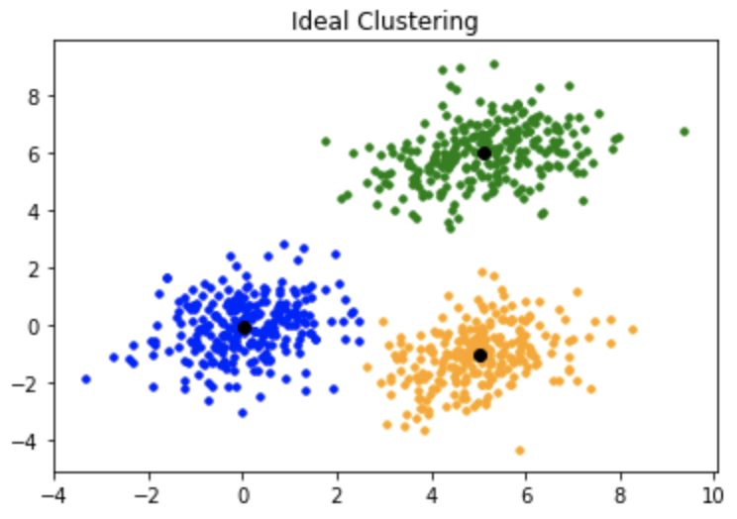
K-Means ++
A poor initialization of centroids resulted in poor clustering.
K-means++ is an improvement over the standard K-means clustering algorithm that provides a more effective initialization method for selecting the initial centroids.

Slide 24
K-Means ++
Randomly select the first centroid from the data points.
For each data point compute its distance from the nearest, previously chosen centroid.
Select the next centroid from the data points such that the probability of choosing a point as centroid is directly proportional to its distance from the nearest, previously chosen centroid. (i.e. the point having maximum distance from the nearest centroid is most likely to be selected next as a centroid)
Repeat steps 2 and 3 until k centroids have been sampled.
By following this initialization procedure, K-means++ encourages the selection of centroids that are far apart from each other, leading to a more representative initialization and better convergence of the algorithm. It helps in avoiding suboptimal solutions that can occur with random initialization, where clusters might be initialized close to each other or with insufficient representation.
Once the initial centroids are determined using K-means++, the standard K-means algorithm proceeds with the assignment and update steps, iterating until convergence.
Notes:
How K-means++ Works:
First Centroid: It starts by selecting the first centroid randomly from the data points.
Next Centroids:For each data point compute its distance from the nearest, previously chosen centroid. The point having maximum distance from the nearest centroid have a higher chance of being selected as the next centroid.
Repeat: This process continues until all K centroids are chosen.
By choosing centroids that are far apart, K-means++ avoids poor initial centroids that could result in bad clustering.

Slide 25
What Is the Problem of the K-Means Method?
The k-means algorithm is sensitive to outliers !
Since an object/data point with an extremely large value may substantially distort the distribution of the data
K-Medoids: Instead of taking the mean value of the object in a cluster as a reference point, medoids can be used, which is the most centrally located object in a cluster

Slide 26
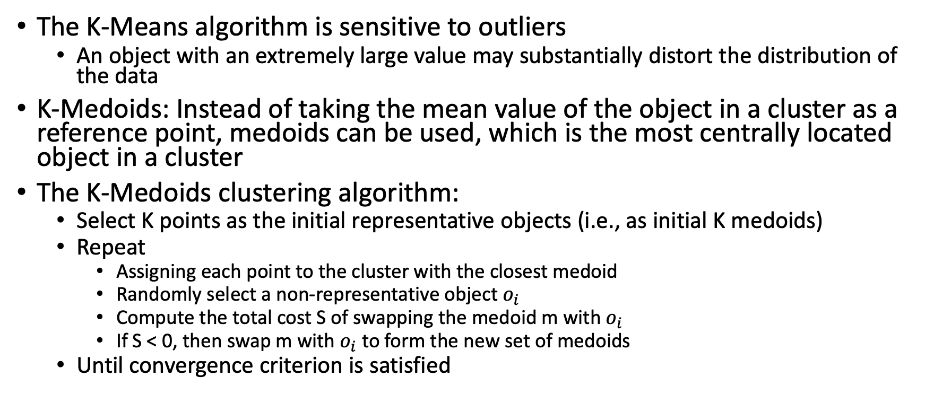
K-Medoids ( Partition Around Medoid – PAM)
Handling Outliers: From K-Means to K-Medoids
https://www.geeksforgeeks.org/ml-k-medoids-clustering-with-example/
Notes:
Start:
Select K initial points (medoids) as the most centrally located objects in the cluster.
Repeat:
Assign each point to the nearest medoid (closest center).
Pick a random object that’s not a medoid.
Calculate the total cost of swapping the current medoid with the randomly selected object.
Swap if the new object reduces the cost (improves clustering).
Stop when the algorithm converges (no more swaps that reduce the cost).

Slide 27
K-Medoids ( Partition Around Medoid – PAM)
Handling Outliers: From K-Means to K-Medoids
Partitioning Around Medoids (PAM) or K-Medoids handles outliers better than other clustering methods like k-means because it is less sensitive to extreme values.
Medoids vs. Centroids:
PAM uses actual data points (medoids) as cluster centers, whereas methods like k-means use centroids (mean of all points in the cluster). Medoids are less affected by outliers since they represent typical points in the dataset, rather than being skewed by extreme values.
https://www.geeksforgeeks.org/ml-k-medoids-clustering-with-example/

Slide 28
K-Medians
K-median clustering is a variant of k-means that addresses some of its weaknesses, especially sensitivity to outliers.
How K-Median Clustering Works:
Initialization: Select k initial medians (central points in clusters), often chosen randomly from the data points.
Assignment Step: For each data point, assign it to the nearest median based on a distance metric, often the Manhattan distance (L1 norm) instead of Euclidean distance (L2 norm) used in k-means. The choice of the Manhattan distance plays a key role in improving the handling of outliers.
Update Step: After assigning all points to clusters, update the median of each cluster. The median is the point within a cluster that minimizes the sum of distances to all other points in the cluster. This contrasts with k-means, which updates using the mean, which can be heavily influenced by outliers.
Repeat: Repeat the assignment and update steps until convergence (when cluster assignments no longer change significantly or the medians stabilize).
Notes:
K-Median Clustering (Simplified):
Initialization:
Pick K initial medians (central points in clusters) from the data points.
Assignment Step:
For each data point, assign it to the nearest median using Manhattan distance (L1 norm), which is less sensitive to outliers compared to Euclidean distance (L2 norm used in K-Means).
Update Step:
After assigning points, update each cluster’s median. The median is the point that minimizes the distance to all other points in the cluster, which helps avoid outliers affecting the result (unlike K-Means, which uses the mean).
Repeat:
Keep repeating the steps (assign and update) until the cluster assignments no longer change.
Key points for exams:
K-Median uses the median (central point) and Manhattan distance to reduce sensitivity to outliers, unlike K-Means which uses the mean.

Slide 29
How K-Median Handles Outliers
Median Calculation: The key reason k-median is robust to outliers is the use of the median instead of the mean for updating the cluster center. The median is the middle value of the data and is not as influenced by extreme values. Outliers do not distort the cluster center as much because they do not affect the median the way they affect the mean.
Distance Metric: The use of Manhattan distance (L1 norm) is also more robust to outliers compared to Euclidean distance (L2 norm). Manhattan distance measures straight-line distance (absolute differences), reducing the impact of large deviations caused by outliers.
Isolated Outliers: Outliers typically have larger distances to other points and are less likely to shift the median significantly. They might either form their own small clusters or remain on the fringes of existing clusters without changing the structure.

Slide 30
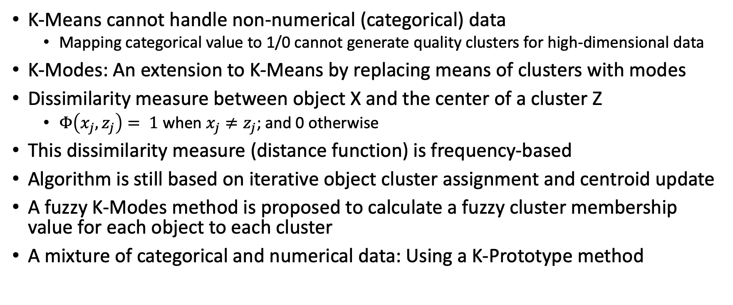
K-Modes: Clustering Categorical Data
Notes:
Initialize Clusters:
Randomly select K points from the data as initial cluster centers (modes).
Assign Data Points to Clusters:
Assign each data point to the nearest cluster based on matching categorical values (Hamming distance).
Update Modes:
For each cluster, update the mode by selecting the most frequent category for each feature.
Repeat:
Reassign points and update modes until cluster assignments no longer change or a stopping condition is met.
Output:
The algorithm returns the final cluster assignments and modes.
This method works well for clustering categorical data.

Slide 31
Kernel K-Means Clustering
Kernel K-Means can be used to detect non-convex clusters
K-Means can only detect clusters that are linearly separable
Idea: Project data onto the high-dimensional kernel space, and then perform K-Means clustering
Map data points in the input space onto a high-dimensional feature space using the kernel function
Perform K-Means on the mapped feature space
Computational complexity is higher than K-Means
Need to compute and store n x n kernel matrix generated from the kernel function on the original data
The widely studied spectral clustering can be considered as a variant of Kernel K-Means clustering
Notes:
Kernel K-Means:
Used for detecting non-convex clusters by mapping data into higher-dimensional space using a kernel function.

Slide 32
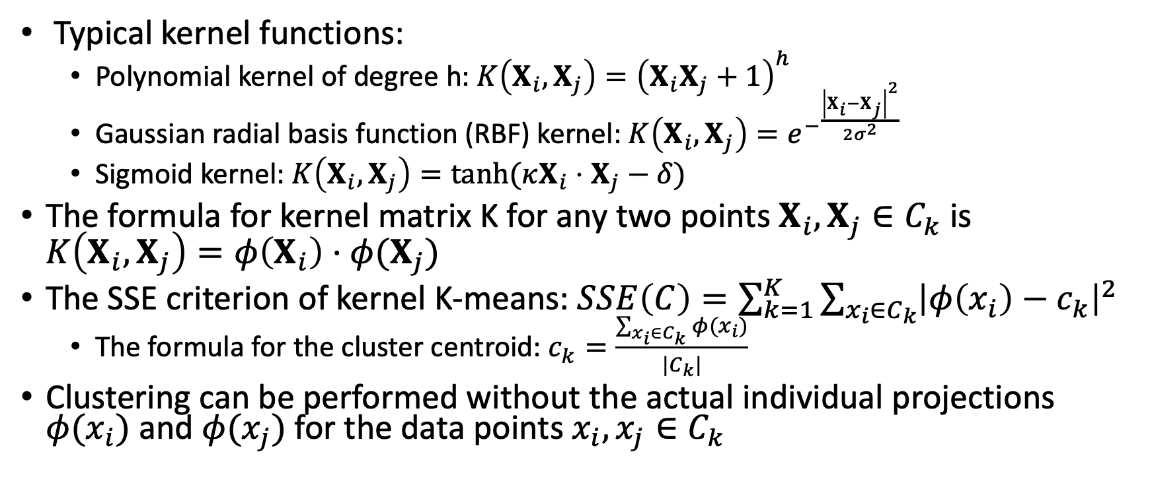
Kernel Functions and Kernel K-Means Clustering
Notes:
Kernel K-Means steps:
Select K and a kernel function (e.g., RBF).
Initialize clusters with random centers.
Map data to a higher-dimensional space using the kernel.
Assign points to the closest cluster in the transformed space.
Update centers based on new assignments.
Repeat until assignments stop changing.

Slide 33
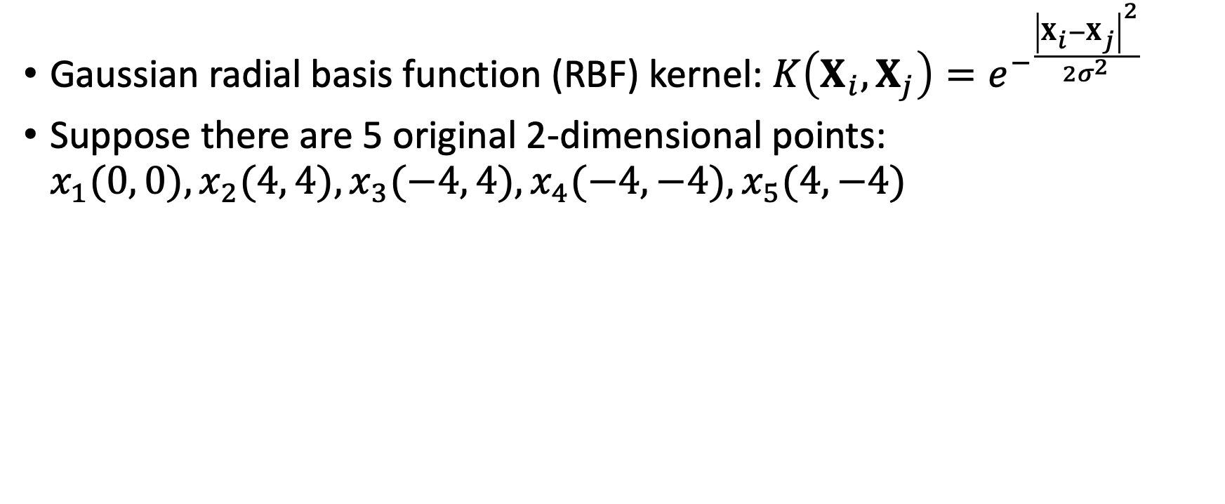
Kernel Functions and Kernel K-Means Clustering
Example: Kernel Functions and Kernel K-Means Clustering

Slide 34
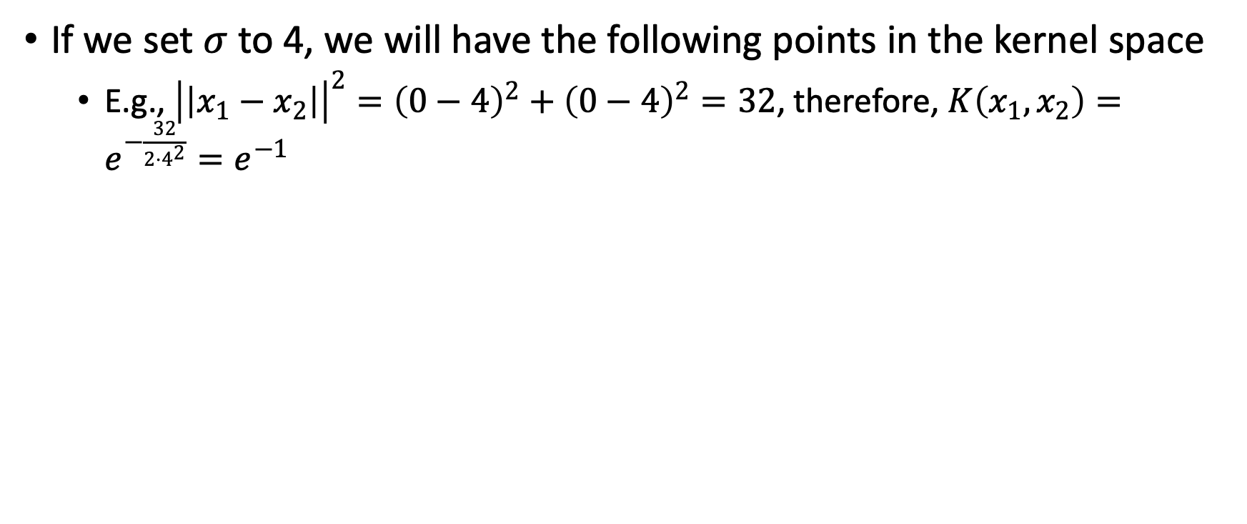
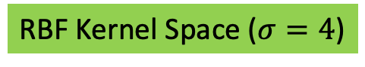
Kernel Functions and Kernel K-Means Clustering
Original Space
K(Xi,X1) | K(Xi,X2) | K(Xi,X3) | K(Xi,X4) | K(Xi,X1)
1 | $$e^{−1}$$ | $$e^{−1}$$ | $$e^{−1}$$ | $$e^{−1}$$
$$e^{−1}$$ | 1 | $$e^{−2}$$ | $$e^{−4}$$ | $e^{−2}$
$$e^{−1}$$ | $$e^{−2}$$ | 1 | $$e^{−2}$$ | $$e^{−4}$$
$$e^{−1}$$ | $$e^{−4}$$ | $$e^{−2}$$ | 1 | $$e^{−2}$$
$$e^{−1}$$ | $$e^{−2}$$ | $$e^{−4}$$ | $$e^{−2}$$ | 1
 | x | y
x₁ | 0 | 0
x₂ | 4 | 4
x₃ | -4 | 4
x₄ | -4 | -4
x₅ | 4 | -4

Slide 35
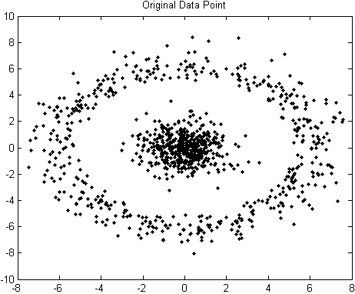
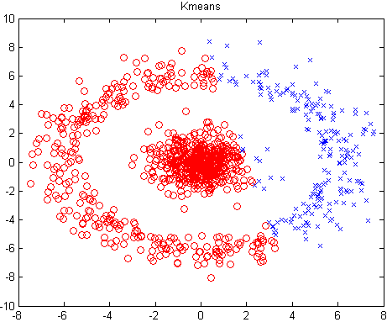
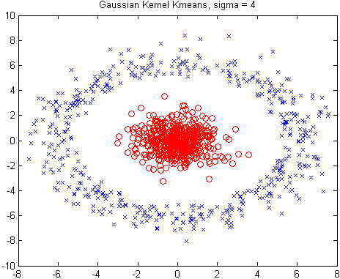
Kernel Functions and Kernel K-Means Clustering

